Slide 1
House sale prices across King County, including Seattle
Manel Ait Amer

Slide 2
What is it about?
Our mission is to delve into a dataset of house sale prices for King County, including Seattle, spanning one year from May 2014 to May 2015. This project encompasses various computational tasks such as data loading, visualization, calculating returns, and portfolio analysis, tailored to the real estate domain.

Slide 3
Our Data:
features 21 different columns, providing a comprehensive overview of the real estate market:
id: A unique identifier for a house.
date: The date on which the house was sold.
price: The sale price of the house (prediction target).
bedrooms: Number of bedrooms in the house.
bathrooms: Number of bathrooms in the house, per bedroom.
sqft_living: Square footage of the interior living space.
sqft_lot: Square footage of the land space.
floors: Number of floors (levels) in the house.
waterfront: Whether the house has a waterfront view.
view: Number of times the house has been viewed.
condition: The overall condition of the house.
grade: The overall grade given to the house, based on the King County grading system.
sqft_above: Square footage of the house apart from the basement.
sqft_basement: Square footage of the basement.
yr_built: The year the house was built.
yr_renovated: The year the house was renovated.
zipcode: ZIP code area.
lat: Latitude coordinate.
long: Longitude coordinate.
sqft_living15: The interior living space for the nearest 15 neighbors in 2015.
sqft_lot15: The land spaces for the nearest 15 neighbors in 2015.
TARGET --> Price: Our primary focus is to understand which features most significantly impact the house price. Additionally, we aim to explore properties valued at $650K and above for more detailed insights.
king_ country_ houses_aa | Kaggle

Slide 4
Data cleaning:
Our data doesn’t contain any duplicates , NaN or spaces so:
Copy our data under king_data.
Clean the date column, transforming it to numerical column.
Setting the Id column as index to reduce the number of columns.
Creating a new boolean columns for the renovated houses and viewed houses.
Drop the grade column.
Delete the columns yr_renovated and view.
Moving the price column at the end (since it is our target).

Slide 5
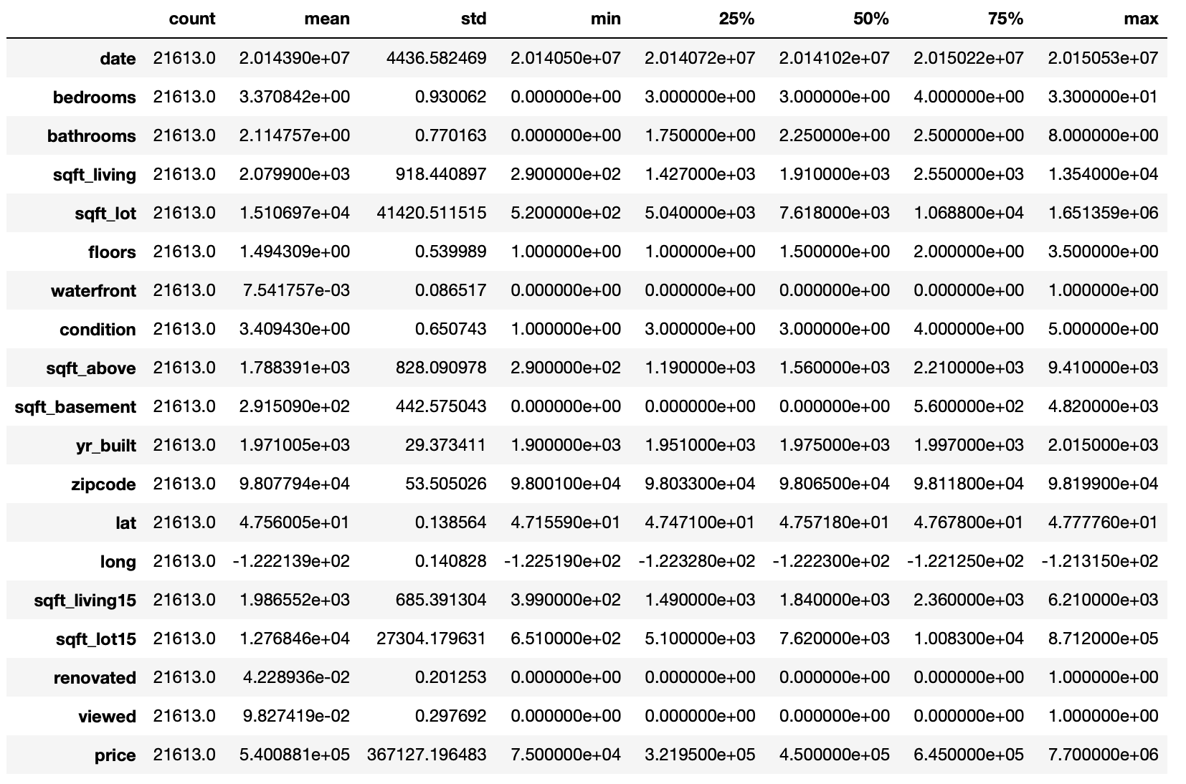
Data description:

Slide 6
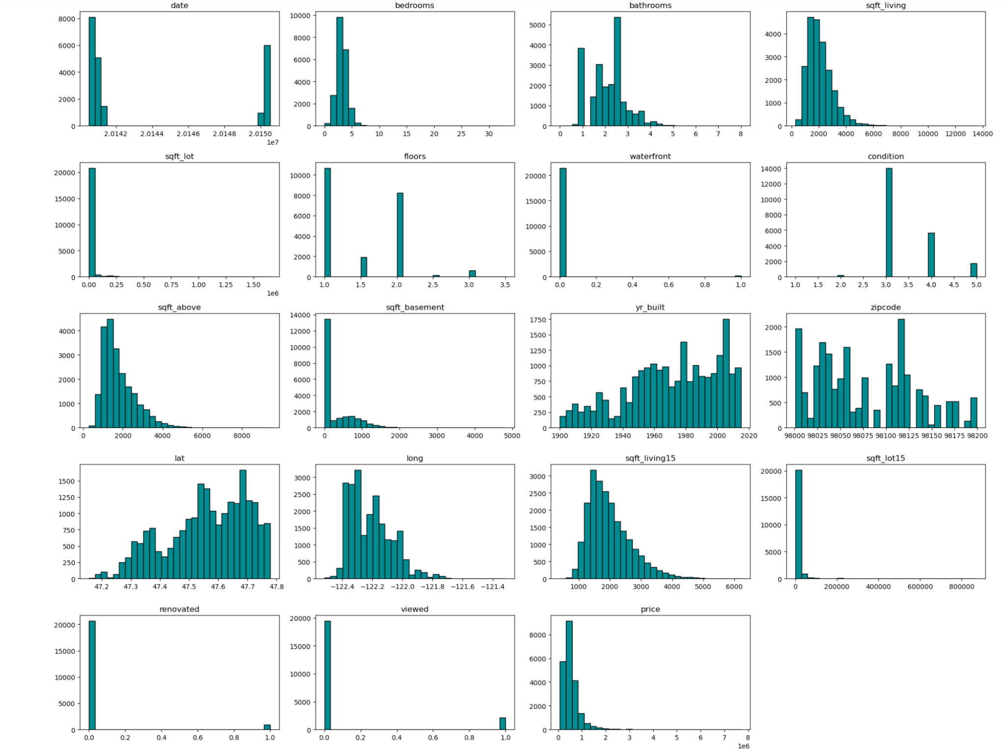
Distribution plots:

Slide 7
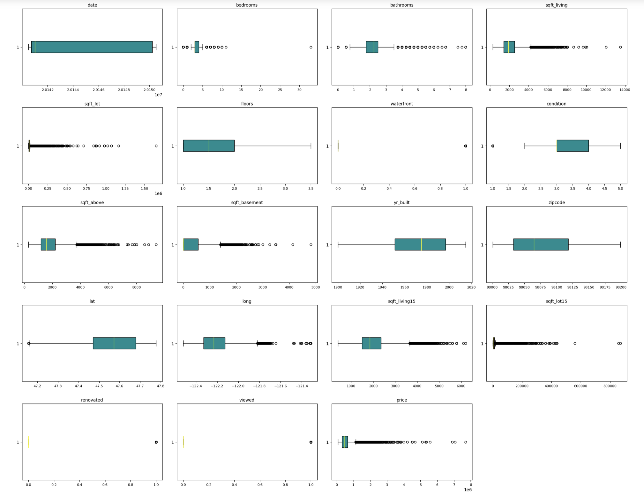
Checking outliers:

Slide 8
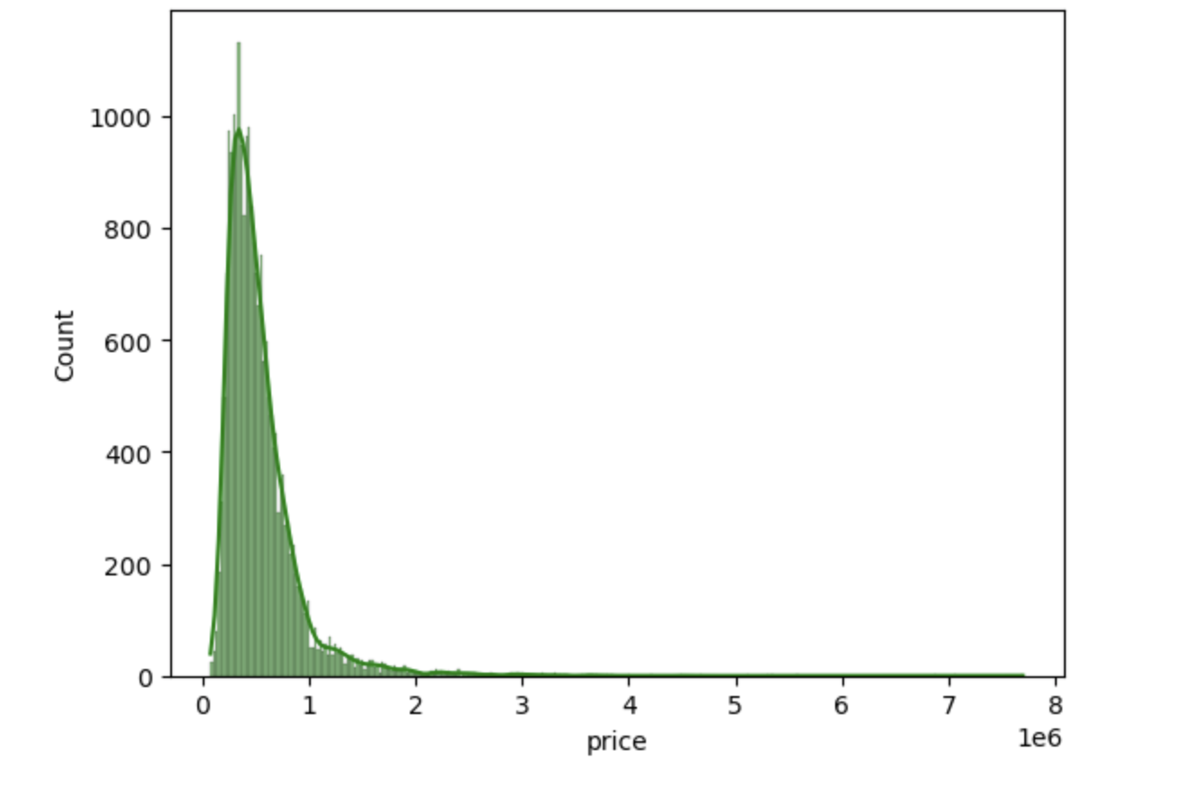
Price distribution:

Slide 9
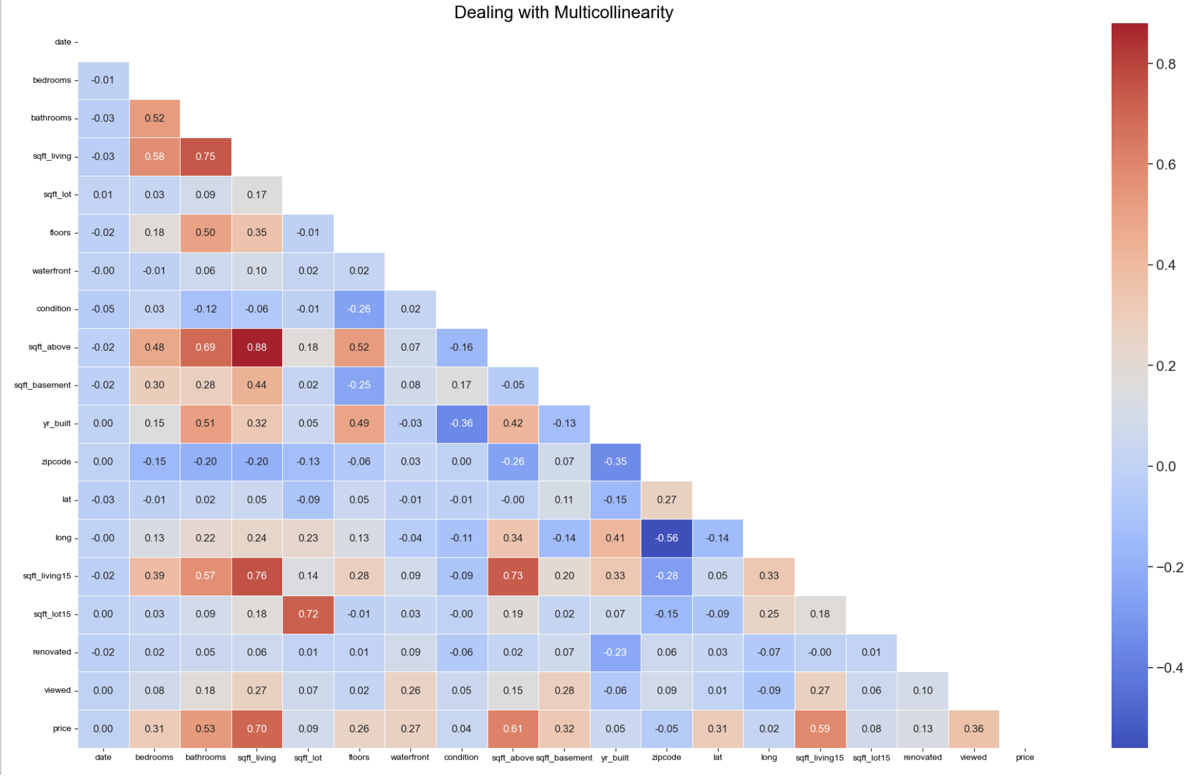
Correlation Heatmap
It is not necessary but I decided to drop the column sqft_above.

Slide 10
Data Preprocessing:
Here we will split our data in X and y.
In X we have all the columns except the target column (price) , and y has only the target column.
The model we chosed is 70% - 30%.
100% of our data: 21613.
70% for training data: 15129.
30% for test data: 6484.
We will select different models , to finally chose the one that has better result.

Slide 11
Our outputs while trying the models are :
R-squared (R²): Indicates the proportion of the variance in the dependent variable. Higher R² values signify a better fit.
Root Mean Squared Error (RMSE): Measures the average magnitude of the errors between predicted and actual values. Lower RMSE indicates better predictive accuracy.
Mean Absolute Error (MAE): Represents the average absolute difference between predicted and actual values. Lower MAE indicates better model performance.
Mean Squared Error (MSE): Measures the average of the squares of the errors—that is, the average squared difference between the predicted and actual values. Lower MSE indicates a better fit and fewer large errors.

Slide 12
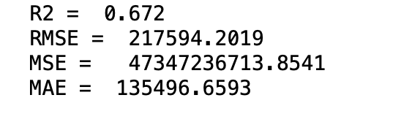
Linear Regression:
0.672 means that 67.2% of the variance in the dependent variable is explained by the model. Though there is still 32.8% of the variance unexplained by the model, indicating room for improvement or the presence of other influencing factors not included in the model.
We will try other models.

Slide 13
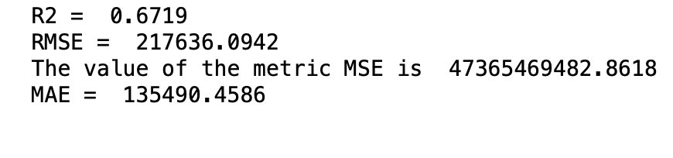
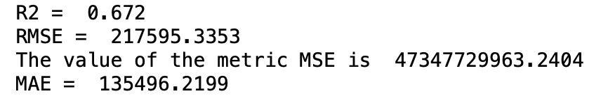
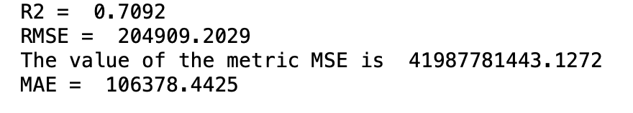
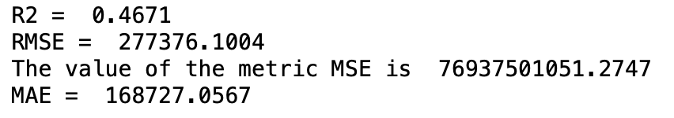
To improve the model, we will use Ridge regression, Lasso regression ,Decision Tree regression , KNN regression and XGBoost Regression.
Ridge regression
Lasso regression
Decision Tree regression
KNN regression
XGBoost regression

Slide 14
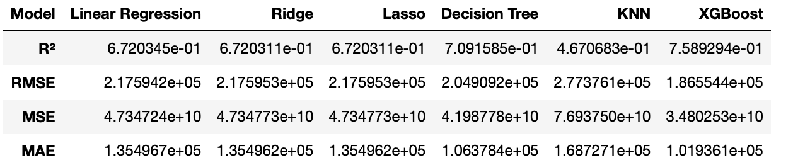
Comparison:
The best model here is the Decision tree regression.

Slide 15
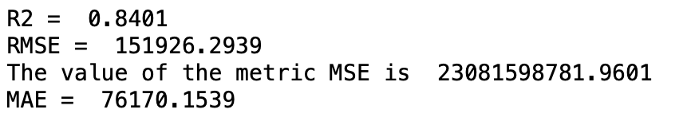
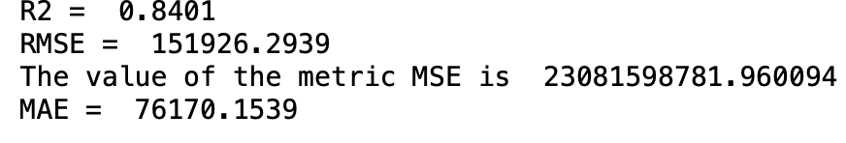
Normalization:
Now we will use 2 models of normalization: MinMaxScaler and StandardScaler.
MinMaxScaler
StandardScaler

Slide 16
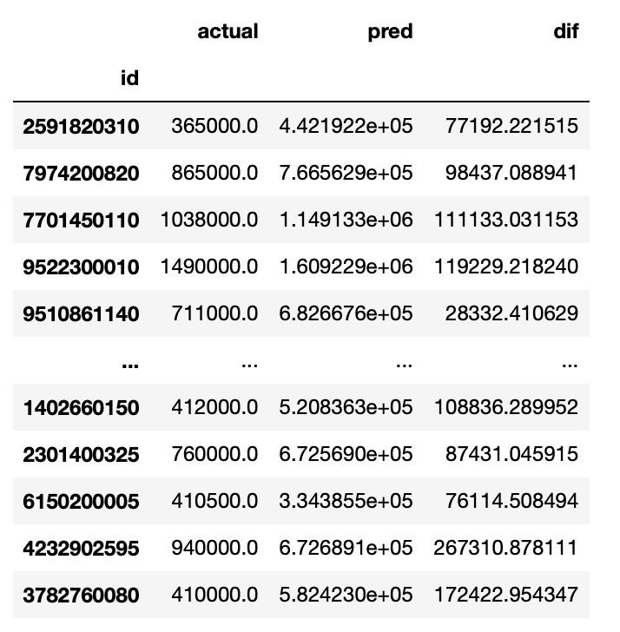
Comparison with prediction:
In this table , we will compare the actual Data with our predicted data.
'actual': The actual values from the test dataset (y_test).
'pred': The predicted values from the linear regression model (predictions).
'Dif' :which contains the absolute differences between the actual values and the predicted values.

Slide 17
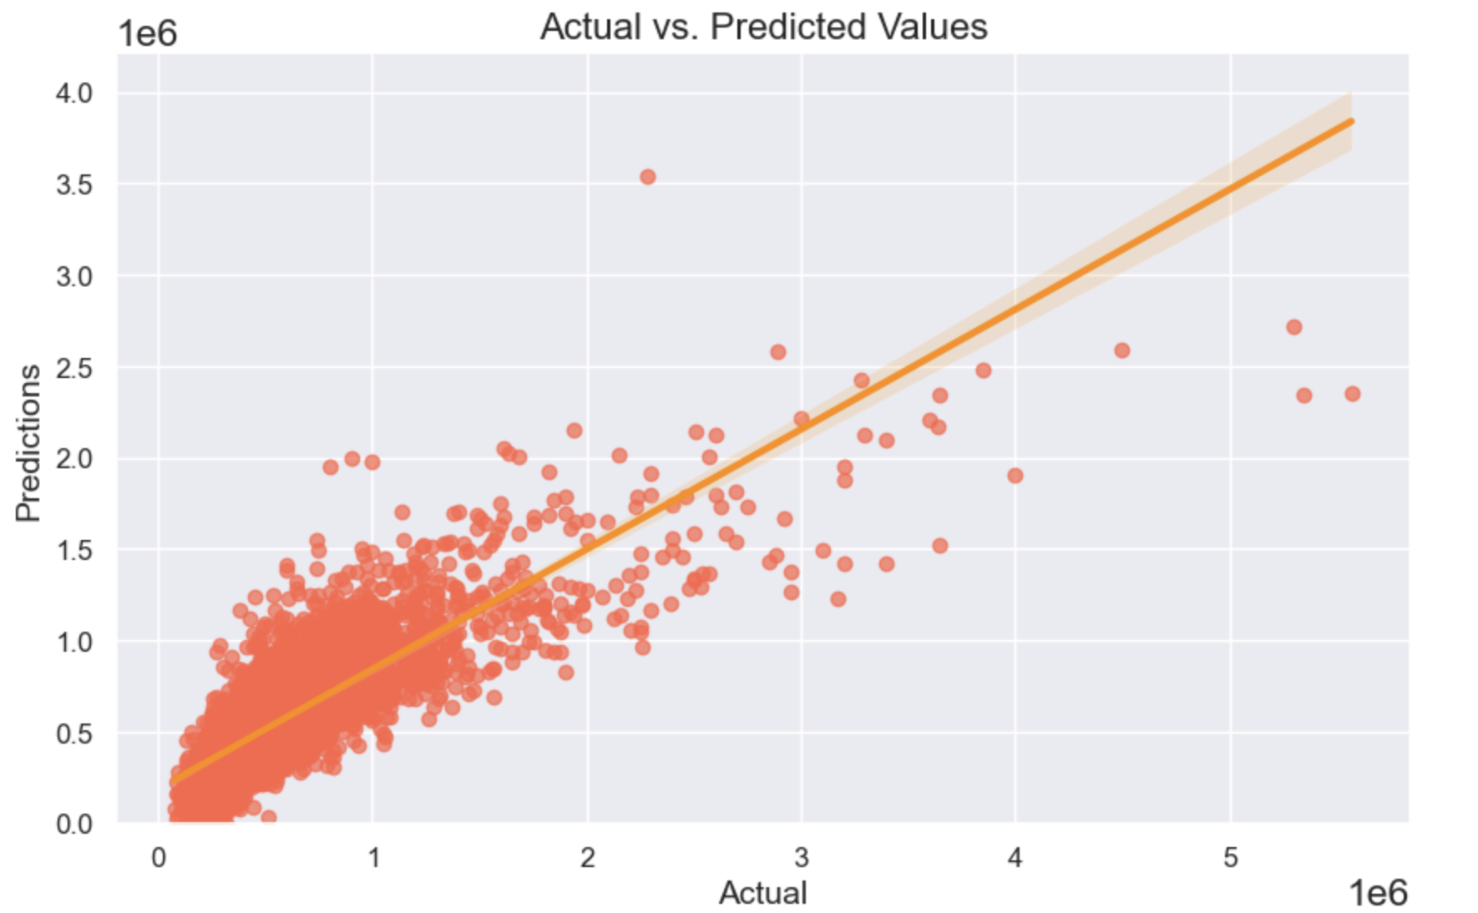
Scatter Plot “actual” and “pred”:

